Slide 1
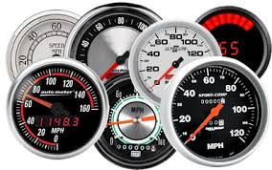
Accelerator-level Parallelism Mark D. Hill, Wisconsin & Vijay Janapa Reddi, Harvard
@ IISWC/Orlando, November 2019
Aspects of this work on Mobile SoCs and Gables were developed while the authors were “interns” with Google’s Mobile Silicon Group. Thanks!

Slide 2
Accelerator-level Parallelism Mark D. Hill
University of Wisconsin-Madison
Abstract:
Computer system performance has improved due to creatively using more transistors (Moore’s Law) in parallel via bit-, instruction-, thread-, and data-level parallelism. With the slowing of technology scaling, the only known way to further improve computer system performance under energy constraints is to employ hardware accelerators. Each accelerator is a hardware component that executes a targeted computation class faster and usually with (much) less energy. Already today, many chips in mobile, edge and cloud computing concurrently employ multiple accelerators in what we call accelerator-level parallelism (ALP).
This talk develops our hypothesis that ALP will spread to computer systems more broadly. ALP is a promising way to dramatically improve power-performance to enable broad, future use of deep AI, virtual reality, self-driving cars, etc. To this end, we review past parallelism levels and the ALP already present in mobile systems on a chip (SoCs). We then aid understanding of ALP with the Gables model and charge computer science researchers to develop better ALP “best practices” for: targeting accelerators, managing accelerator concurrency, choreographing inter-accelerator communication, and productively programming accelerators. This joint work with Vijay Janapa Reddi of Harvard. See also: https://www.sigarch.org/accelerator-level-parallelism/
Biography:
Mark D. Hill (http://www.cs.wisc.edu/~markhill) is John P. Morgridge Professor and Gene M. Amdahl Professor of Computer Sciences at the University of Wisconsin-Madison, where he also has a courtesy appointment in Electrical and Computer Engineering. His research interests include parallel-computer system design, memory system design, and computer simulation. He received the 2019 Eckert-Mauchly Award and is a fellow of IEEE and the ACM. He serves as Chair of the Computer Community Consortium (2018-19) and served as Wisconsin Computer Sciences Department Chair 2014-2017. Hill has a PhD in computer science from the University of California, Berkeley.

Slide 3





Computing Community Consortium (CCC): Catalyzing I.T.’s Virtuous Cycle
Citizens
Industry
Government
Academia
Get involved w/ white papers, workshops, & advocating I.T. research
(to do good & make your research better)
Notes:
Established in 2006 as a standing committee of the Computing Research Association
Funded by NSF under a Cooperative Agreement
Facilitates the development of a bold, multi-themed vision for computing research – and communicates this vision to stakeholders
Led by a broad-based Council
Staffed by CRA

Slide 4
Accelerator-level Parallelism Call to Action
Future apps demand much more computing
Standard tech scaling & architecture NOT sufficient
Mobile SoCs show a promising approach:
ALP = Parallelism among workload components concurrently executing on multiple accelerators (IPs)
Call to action to develop “science” for ubiquitous ALP

Slide 5
Outline
Computer History & X-level Parallelism
Mobile SoCs as ALP Harbinger
Gables ALP SoC Model
Call to Action for Accelerator-level Parallelism

Slide 6
20th Century Information & Communication Technology
Has Changed Our World
<long list omitted>
Required innovations in algorithms, applications, programming languages, … , & system software
Key (invisible) enablers (cost-)performance gains
Semiconductor technology (“Moore’s Law”)
Computer architecture (~80x per Danowitz et al.)
6

Slide 7
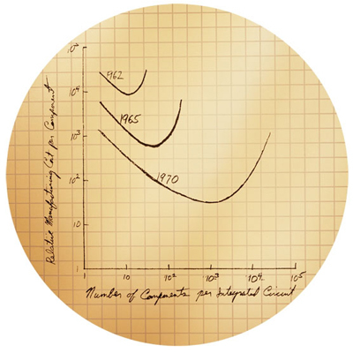
Moore’s Law – 1965 Paper
Optimal number of transistors per chip with increase with time
Became self-fulfilling prophesy with doubling transistor count every ~ two years
Note that transistor gain in two years equals all past gain – the power of an exponential!

Slide 8
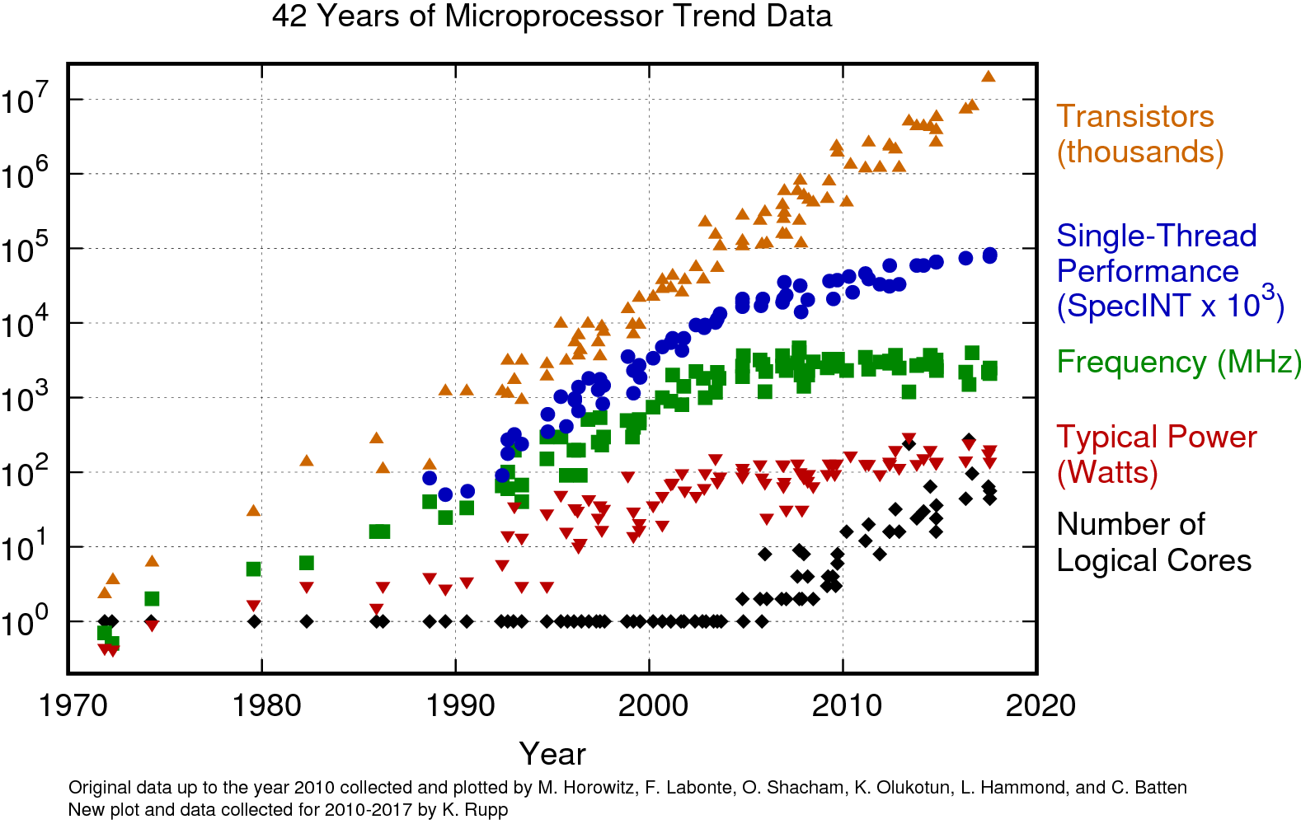
https://www.karlrupp.net/wp-content/uploads/2018/02/42-years-processor-trend.png

Slide 9
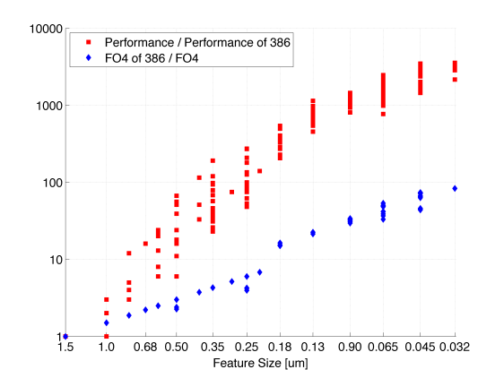
Enablers: Technology + Architecture
Architecture
Technology
Danowitz et al., CACM 04/2012

Slide 10
How did Architecture Exploit Moore’s Law?
MORE (& faster) transistors ➔ even faster computers
Memory – transistors in parallel
Vast semiconductor memory (DRAM)
Cache hierarchy for fast memory illusion
Processing – transistors in parallel
Bit-, Instruction-, Thread-, & Data-level Parallelism
Now Accelerator-level Parallelism
10

Slide 11
X-level Parallelism in Computer Architecture
P
$
bus
M
i/f
dev
1 CPU
BLP+ILP
Bit/Instrn-Level Parallelism

Slide 12
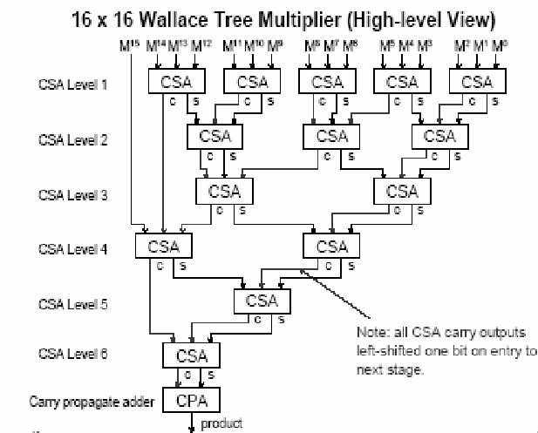
Bit-level Parallelism (BLP)
Early computers: few switches (transistors)
➔ compute a result in many steps
E.g., 1 multiplication partial product per cycle
Bit-level parallelism
More transistors ➔ compute more in parallel
E.g., Wallace Tree multiplier (right)
Larger words help: 8b→16b→32b→64b
Important: Easy for software
NEW: Smaller word size, e.g. machine learning inference accelerators
12

Slide 13
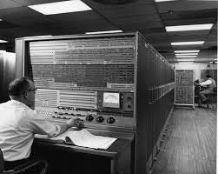
Instruction-level Parallelism (ILP)
Processors logically do instructions sequentially (time→)
add
load
Actually do instructions in parallel ➔ ILP
add
IBM Stretch [1961]
load
branch
Predict direction: target or fall thru
and
Speculate!
store
Speculate more!
E.g., Intel Skylake has 224-entry reorder buffer w/ 14-19-stage pipeline
Important: Easy for software
13

Slide 14
X-level Parallelism in Computer Architecture
P
$
bus
M
i/f
dev
1 CPU
Multiprocessor
BLP+ILP
+ TLP
Bit/Instrn-Level Parallelism
Thread-Level Parallelism

Slide 15
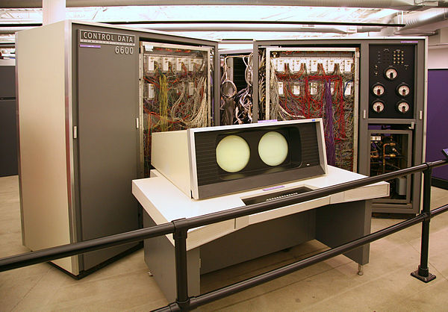
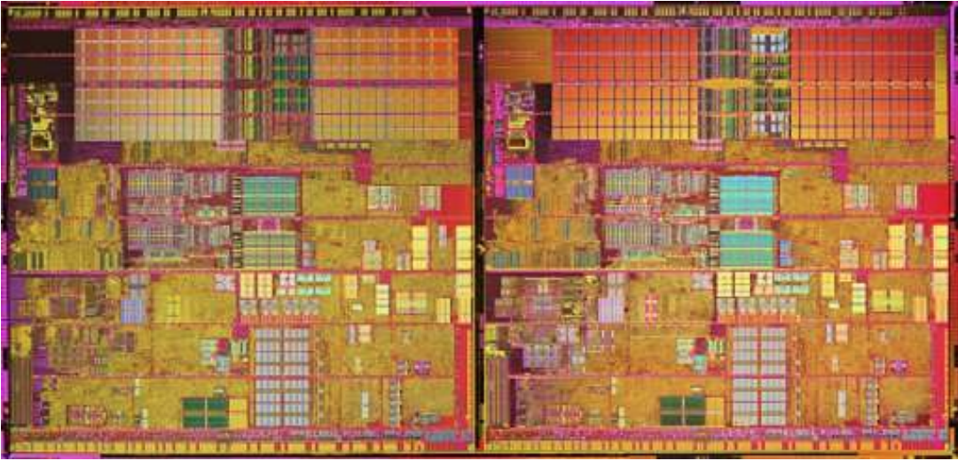
Thread-level Parallelism (TLP)
Thread-level Parallelism
HW: Multiple sequential processor cores
SW: Each runs asynchronous thread
SW must partition work, synchronize, & manage communication
E.g. pThreads, OpenMP, MPI
On-chip TLP called “multicore” – forced choice
Less easy for software but
More TLP in cloud than desktop → cloud!!
Bifurcation: experts program TLP; others use it
Desk hard + server (cloud) EZ ➔ factor in comp to cloud
Many use few program
Old, Niagara pix
CDC 6600, 1964,
(TLP via multithreaded processor)
Intel Pentium Pro Extreme Edition, early 2000s
15

Slide 16
https://www.nytimes.com/2019/10/07/opinion/ai-research-funding.html
https://www.karlrupp.net/wp-content/uploads/2018/02/42-years-processor-trend.png

Slide 17
X-level Parallelism in Computer Architecture
P
$
bus
M
i/f
dev
1 CPU
Multicore
BLP+ILP
+ TLP
Bit/Instrn-Level Parallelism
Thread-Level Parallelism

Slide 18
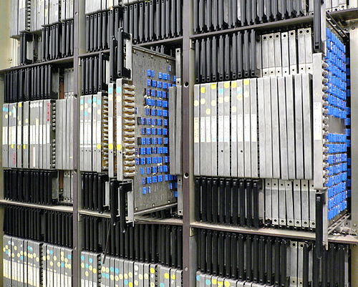
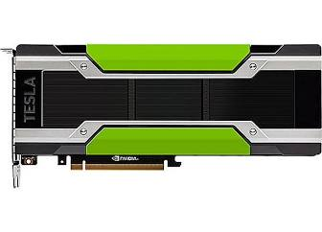
Data-level Parallelism (DLP)
Need same operation on many data items
Do with parallelism ➔ DLP
Array of single instruction multiple data (SIMD)
Deep pipelines like Cray vector machines
Intel-like Streaming SIMD Extensions (SSE)
Broad DLP success awaited General-Purpose GPUs
Single Instruction Multiple Thread (SIMT)
SW (CUDA) & libraries (math & ML)
Experimentation as $1-10K not $1-10M
Bifurcation again: experts program SIMT (TLP+DLP); others use it
Pix: cray, cm-5, gpu
Illinois ILLIAC IV, 1966
NVIDIA Tesla
18

Slide 19
X-level Parallelism in Computer Architecture
P
$
bus
dev-M
M
i/f
GPU
dev
1 CPU
Multicore
Discrete GPU
BLP+ILP
+ TLP
+ DLP
Bit/Instrn-Level Parallelism
Thread-Level Parallelism
Data-Level Parallelism

Slide 20
X-level Parallelism in Computer Architecture
P
GPU
$
bus
M
i/f
dev
1 CPU
Multicore
Integrated GPU
BLP+ILP
+ TLP
+ DLP
Bit/Instrn-Level Parallelism
Thread-Level Parallelism
Data-Level Parallelism

Slide 21
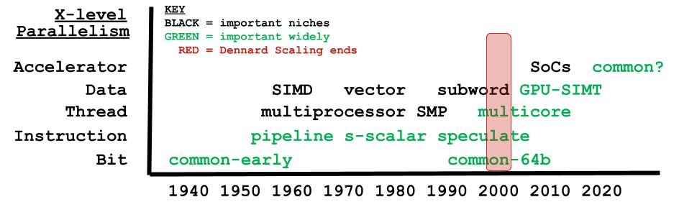
X-level Parallelism in Computer Architecture

Slide 22
Outline
Computer History & X-level Parallelism
Mobile SoCs as ALP Harbinger
Gables ALP SoC Model
Call to Action for Accelerator-level Parallelism

Slide 23
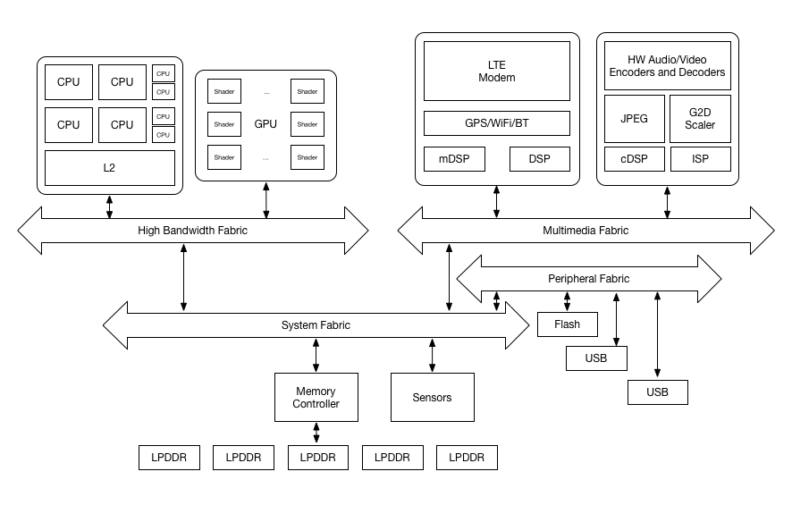
X-level Parallelism in Computer Architecture
P
GPU
$
bus
M
i/f
dev
System on a Chip (SoC)
1 CPU
Multicore
Integrated GPU
BLP+ILP
+ TLP
+ DLP
+ ALP
Bit/Instrn-Level Parallelism
Thread-Level Parallelism
Data-Level Parallelism
Accelerator-Level Parallelism

Slide 24
Mobile SoC HW

Slide 25
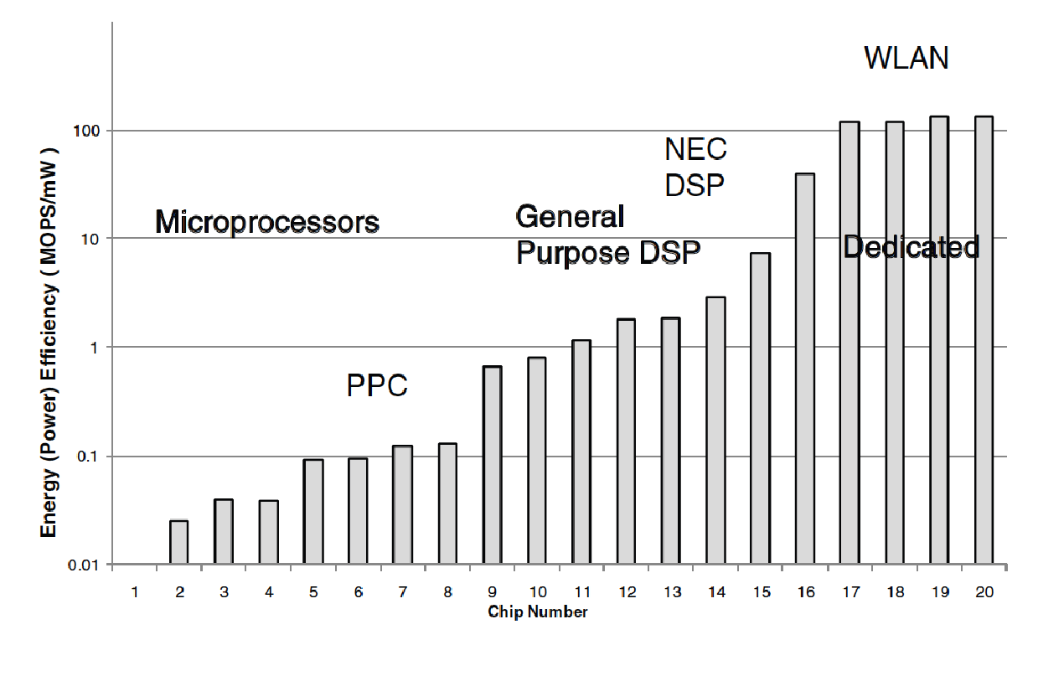
Potential for Specialized Accelerators (IPs)
Accelerator is a hardware component that executes a targeted computation class faster & usually with (much) less energy.
v
16
Encryption
17
Hearing Aid
18
FIR for disk read
19
MPEG Encoder
20
802.11 Baseband
v
[Brodersen & Meng, 2002]

Slide 26
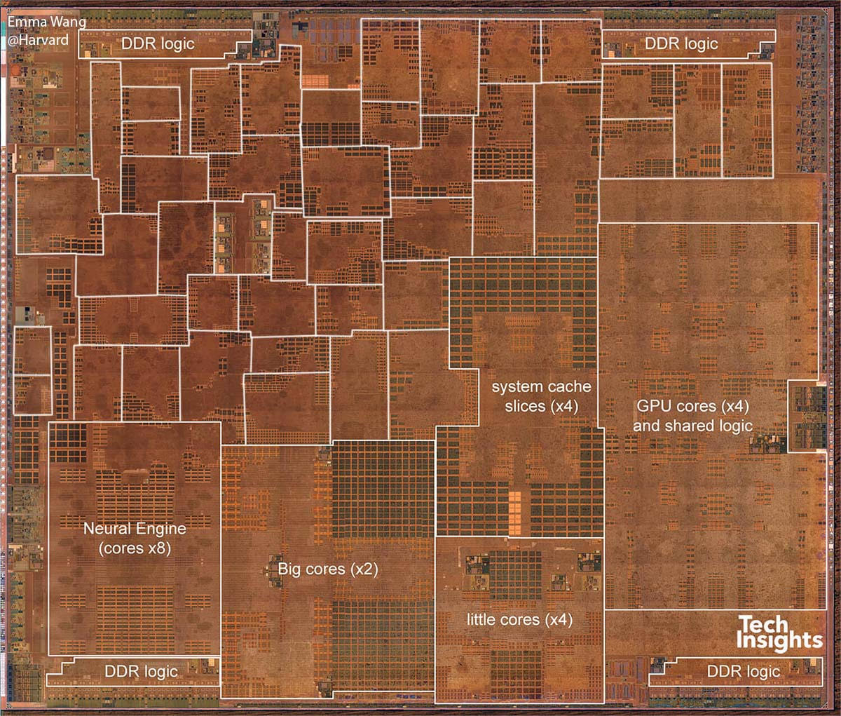
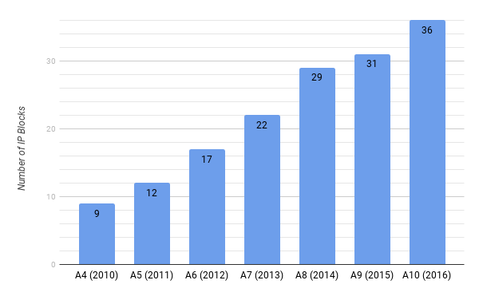
CPU, GPU, xPU (i.e., Accelerators or IPs)
42 Really?
The Hitchhiker's Guide to the Galaxy?
2019 Apple A12 w/ 42 accelerators
26

Slide 27
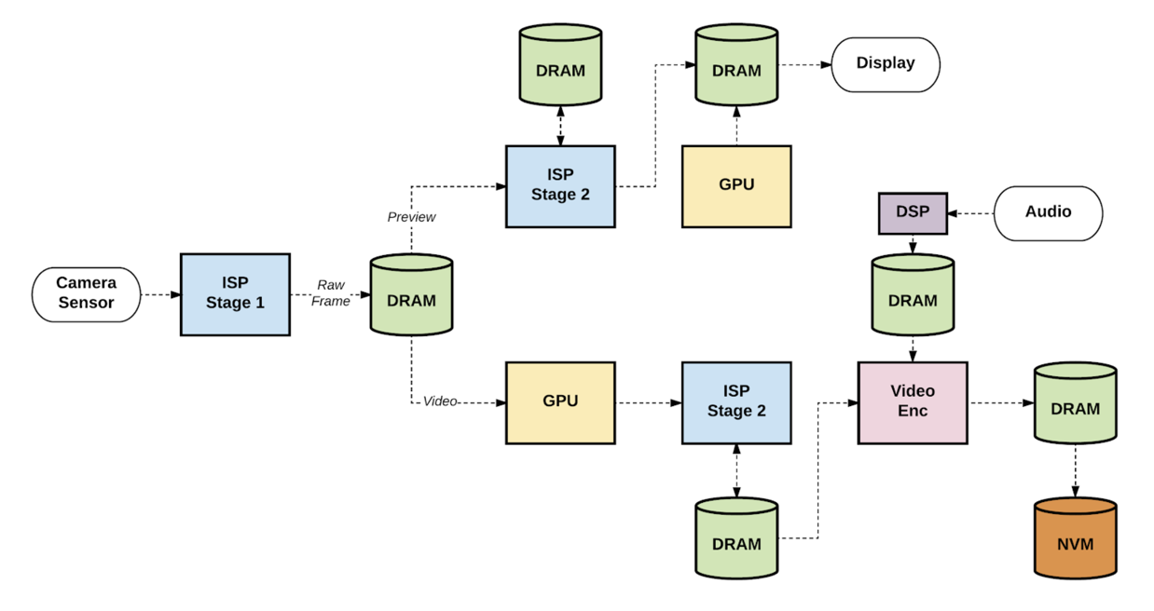
Example Usecase
(recording 4K video)
Janapa Reddi, et al.,
IEEE Micro, Jan/Feb 2019
ALP = Parallelism among workload components concurrently executing on multiple accelerators (IPs)

Slide 28
Mobile SoCs Run Usecases
Accelerators (IPs) ➔ Usecases (rows) | CPUs (AP) | Display | Media Scaler | GPU | Image Signal Proc. | JPEG | Pixel Visual Core | Video Decoder | Video Encoder | Dozens More
Photo Enhancing | X | X |  | X | X | X | X
Video Capture | X | X |  | X | X |  |  |  | X
Video Capture HDR | X | X |  | X | X |  |  |  | X
Video Playback | X | X | X | X |  |  |  | X
Image Recognition | X | X | X | X
Must run each usecase sufficiently fast -- no need faster
A usecase uses IPs concurrently: more ALP than serial
For each usecase, how much acceleration for each IP?
Notes:
Go deeper if time?

Slide 29
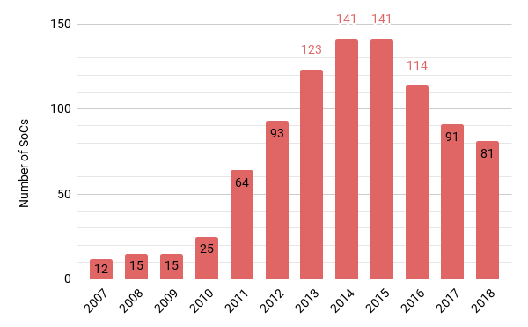
Mobile SoCs Hard To Program For and Select
Envision usecases
(years ahead)
Port to many SoCs??
Diversity hinders use [Facebook, HPCA’19]
What SoC abstraction should SW use?

Slide 30
Mobile SoCs Hard To Design
Envision usecases (2-3 years ahead)
Select IPs
Size IPs
Design Uncore
Which accelerators? How big? How to even start?

Slide 31
Outline
Computer History & X-level Parallelism
Mobile SoCs as ALP Harbinger
Gables ALP SoC Model (ok to get lost)
Call to Action for Accelerator-level Parallelism

Slide 32
Computer Architecture & Models
Accuracy
Effort
Insight
Models vs Simulation
More insight
Less effort
But less accuracy
Multiprocessor & Amdahl’s Law
Multicore & Roofline
Models give first answer, not final answer
Gables extends Roofline ➔ first answer for SoC ALP
Notes:
Don’t skip if possible

Slide 33
Roofline for Multicore Chips, 2009
Multicore HW
P_{peak} = peak perf of all cores
B_{peak} = peak off-chip bandwidth
Multicore SW
I = operational intensity = #operations/#off-chip-bytes
E.g., 2 ops / 16 bytes → I = 1/8
Output P_{att} = upper bound on performance attainable

Slide 34
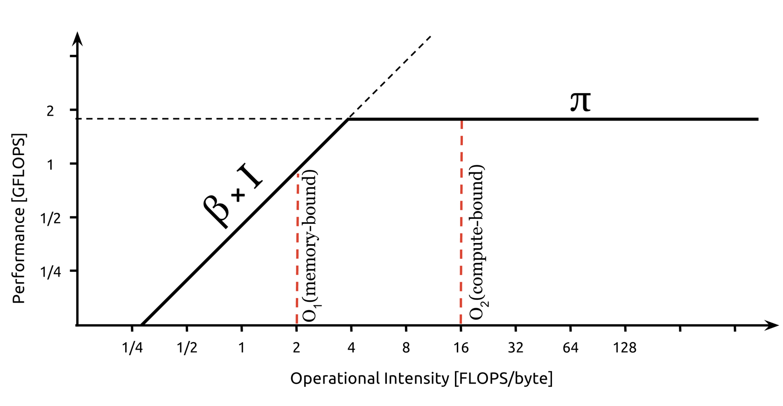
Roofline for Multicore Chips, 2009
(P_{att})
P_{peak}
B_{peak}* I
(I)
Source: https://commons.wikimedia.org/wiki/File:Example_of_a_naive_Roofline_model.svg
Compute v. Communication: Op. Intensity (I) = #operations / #off-chip bytes

Slide 35
ALP System on Chip (SoC) Model:
NEW Gables
2019 Apple A12 w/ 42 accelerators
Gables uses Roofline per IP to provide first answer!
SW: optimize for a “gabled roof?”
HW: select & size accelerators
35

Slide 36
Gables for N IP SoC
A₁*P_{peak}
A_{N-1}*P_{peak}
A₀ = 1
A₀*P_{peak}
CPUs
IP[0]
IP[1]
IP[N-1]
B₀
B₁
B_{N-1}
← Share off-chip B_{peak} →
Usecase at each IP[i]
Operational intensity I_{i} operations/byte
Non-negative work f_{i} (f_{i}’s sum to 1) w/ IPs in parallel
36

Slide 37
Example Balanced Design Start w/ Gables
TWO-IP SoC
P_{peak} = 40
A₁*P_{peak} = 5*40 = 200
IP[0]
CPUs
IP[1]
GPU
Workload (Usecase):
f₀ = 1 & f₁ = 0
I₀ = 8 = good caching
I₁ = 0.1 = latency tolerant
Performance?
B₀ = 6
B₁ = 15
B_{peak} = 10
DRAM

Slide 38
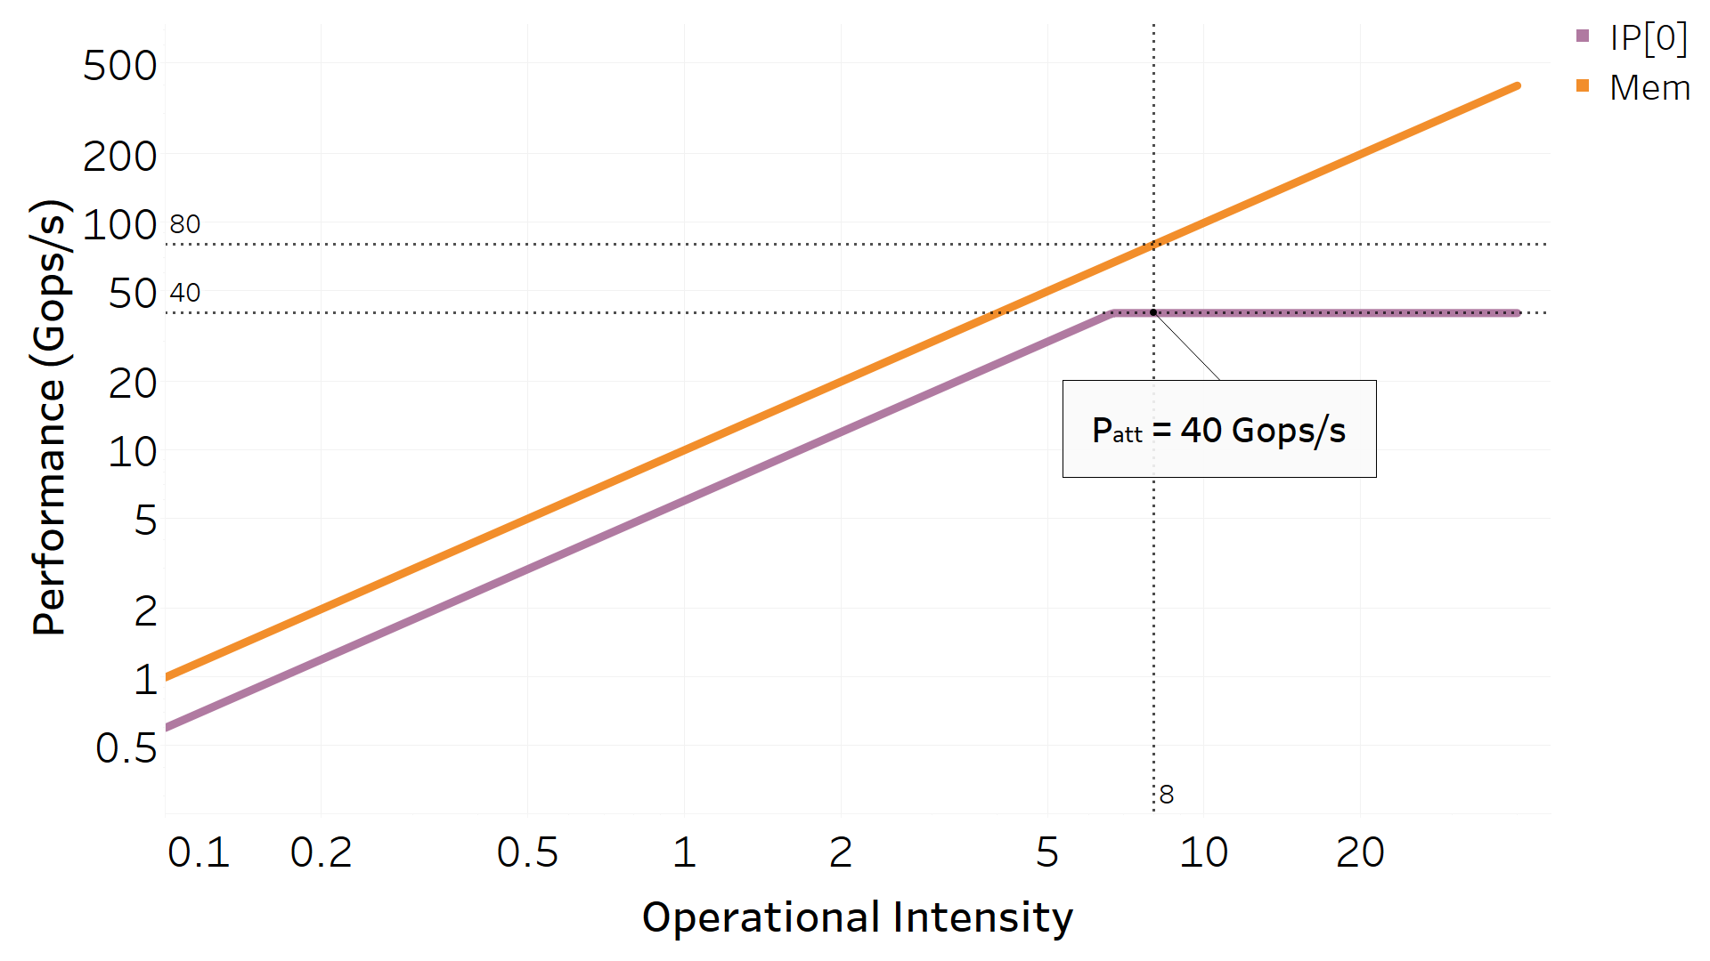
Perf limited by IP[0] at I₀ = 8
I[1] not used → no roofline
Let’s Assign IP[1] work: f₁ = 0 → 0.75
P_{peak} = 40
B_{peak} = 10
A₁ = 5
B₀ = 6
B₁ = 15
f₁ = 0
I₀ = 8
I₁ = 0.1
38
Notes:
Use these slides rather than website.

Slide 39
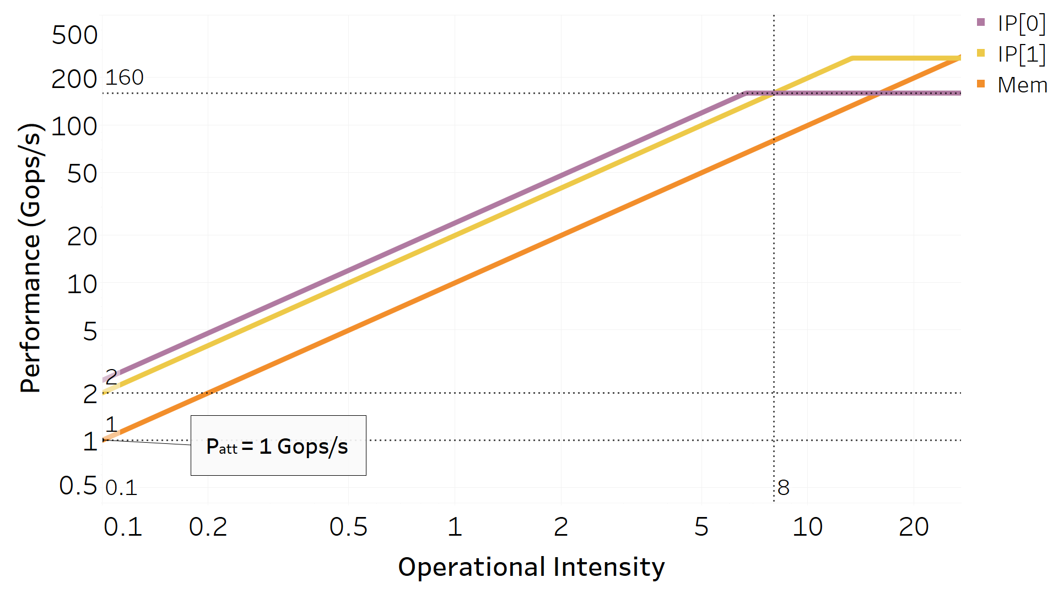
IP[1] present but Perf drops to 1! Why?
I₁ = 0.1 → memory bottleneck
Enhance B_{peak} = 10 → 30 (at a cost)
P_{peak} = 40
B_{peak} = 10
A₁ = 5
B₀ = 6
B₁ = 15
f₁ = 0.75
I₀ = 8
I₁ = 0.1
39

Slide 40
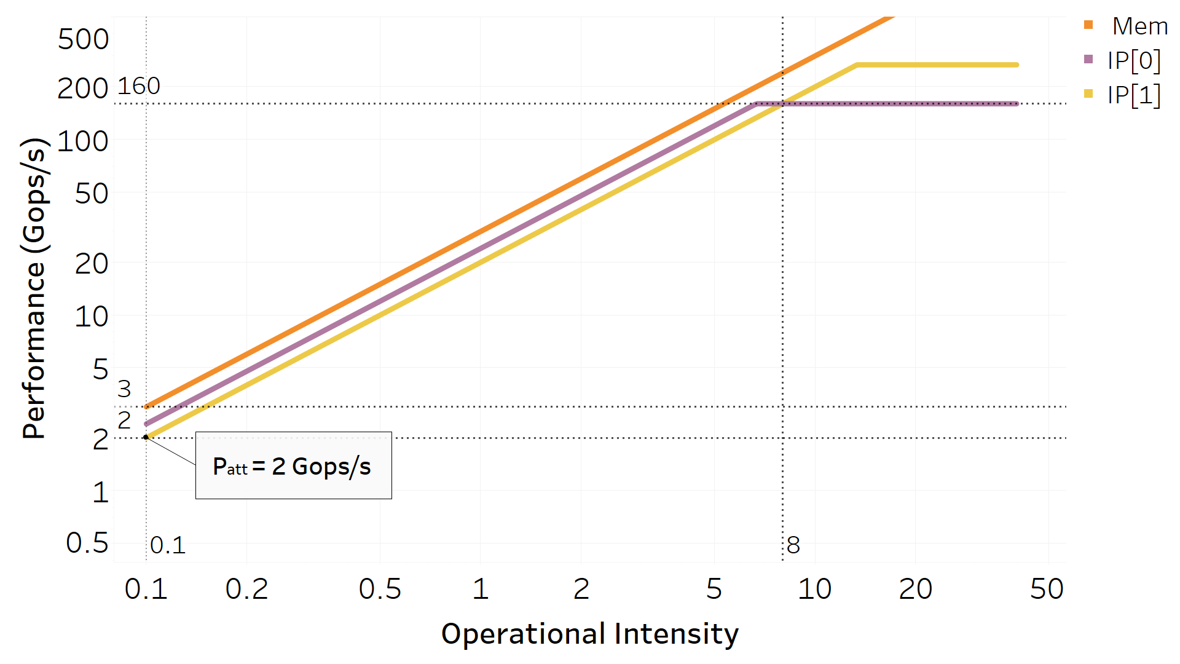
P_{peak} = 40
B_{peak} = 30
A₁ = 5
B₀ = 6
B₁ = 15
f₁ = 0.75
I₀ = 8
I₁ = 0.1
Perf only 2 with IP[1] bottleneck
IP[1] SRAM/reuse I₁ = 0.1 → 8
Reduce overkill B_{peak} = 30 → 20
40

Slide 41
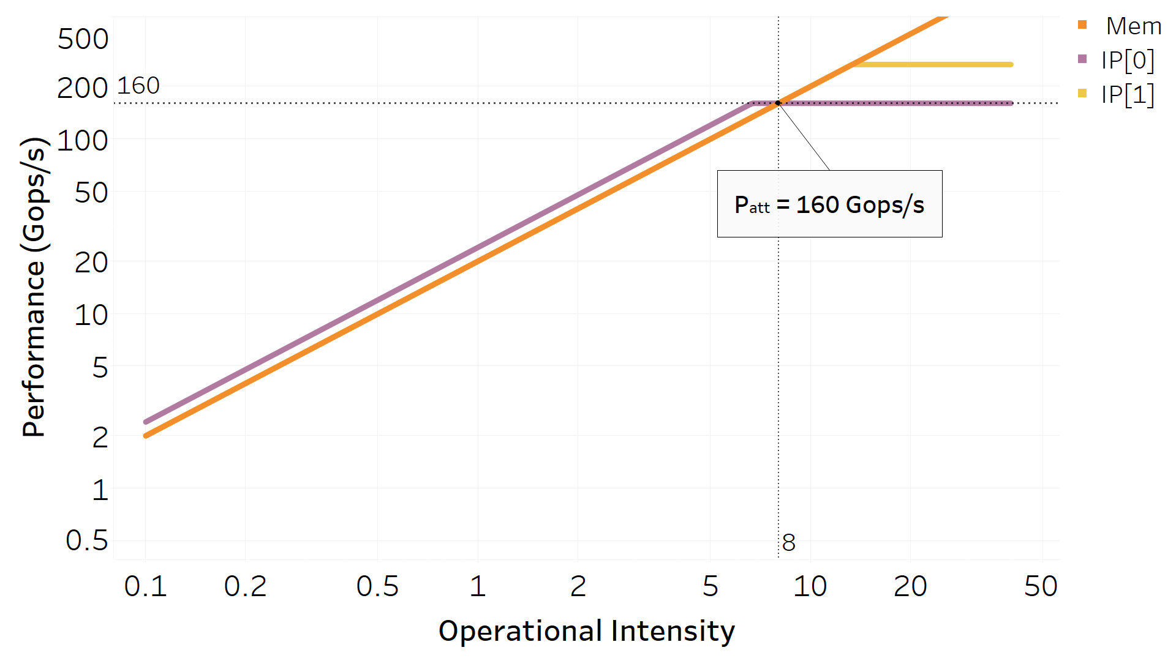
Usecases using K accelerators →
Gables has K+1 rooflines
P_{peak} = 40
B_{peak} = 20
A₁ = 5
B₀ = 6
B₁ = 15
f₁ = 0.75
I₀ = 8
I₁ = 8
Perf = 160 < A*P_{peak} = 200
Can you do better?
It’s possible!
41

Slide 42
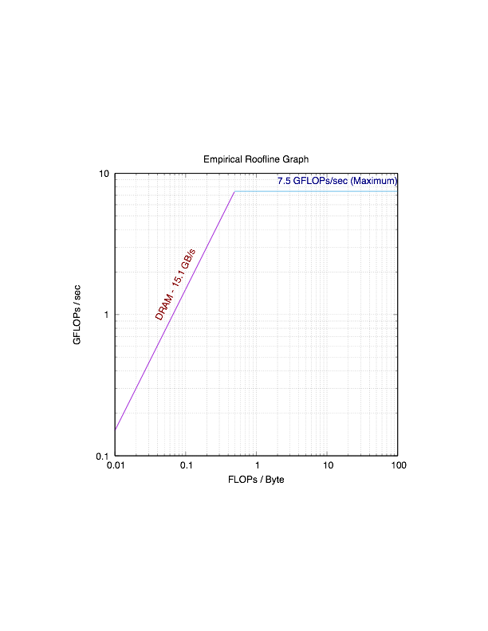
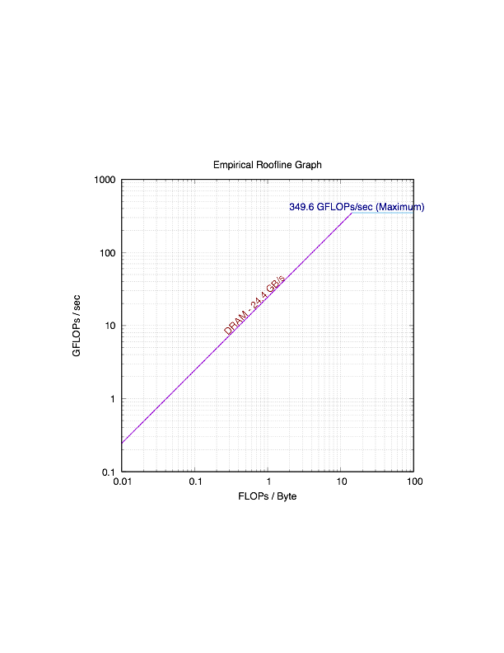
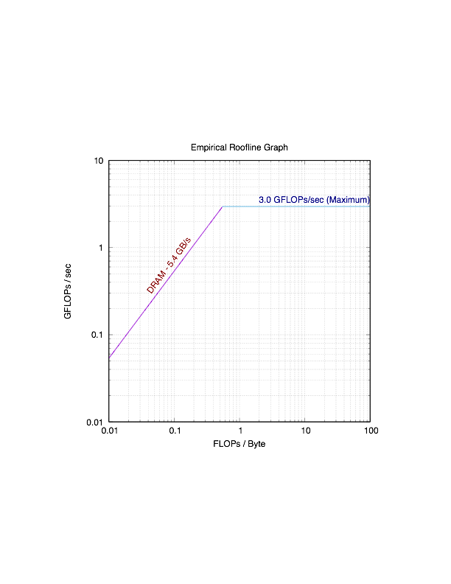
μBenchmark w/ Qualcomm SnapdragonTM 835
All elements load from array & vary FP SP op intensity
Finds empirical lower bound on rooflines
CPUs GPU DSP (SCALAR)
P_{peak} = 7.5 GF A_{GPU} = 47 A_{DSP-SCALAR} = 0.40
Preliminary evidence that multiple rooflines useful

Slide 43
Case Study: IT + CAD Vendors (details TBA)
Two cases where: Gables >> Actual
1. Communication between two IP blocks
Root: Too few buffers to cover communication latency
Little’s Law: # outstanding msgs = avg latency * avg BW
https://www.sigarch.org/three-other-models-of-computer-system-performance-part-1/
Solution: Add buffers; actual performance → Gables
2. More complex interaction among IP blocks
Root: Usecase work (task graph) not completely parallel
Solution: No change, but useful double-check

Slide 44
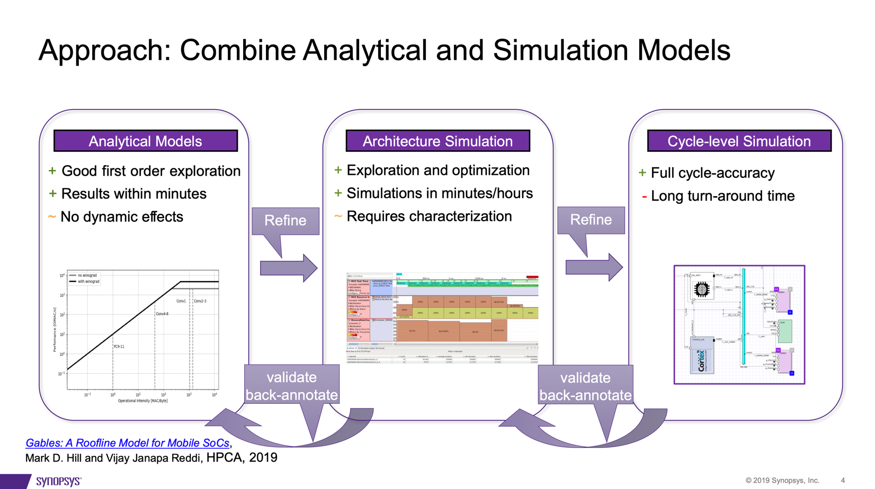
Into Synopsys design flow << 6 months of publication!

Slide 45
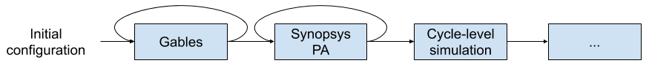

Slide 47
Case Study: Allocating SRAM
IP0
IP2
IP1
SHARED
Where SRAM?
Private w/i each IP
Shared resource

Slide 48
What determines I_{i}?
SW Usecase (most important)
Dense v. sparse matrices
E.g. vision v. audio ML
A_{i}*P_{peak}
IP[i]
P_{att}
M_{i}
Hardware
More A_{i} toward BW-bound (recall f_{i} too!)
More B_{i} toward compute-bound
More M_{i} toward compute-bound if reuse
Whither I_{i} as function of M_{i}?
B_{i}
I_{i}
BW -bound I_{i}
Compute -bound I_{i}
48

Slide 49
Does more IP[i] SRAM help Op. Intensity (I_{i})?
Compute v. Communication: Op. Intensity (I) = #operations / #off-chip bytes
I_{i}
Small W/S
fits
Large W/S fits
Med. W/S fits
Not much fits
W/S = working set
IP[i] SRAM
Non-linear function that increases when new footprint/working-set fits
Should consider these plots when sizing IP[i] SRAM
Later evaluation can use simulation performance on y-axis
49

Slide 50
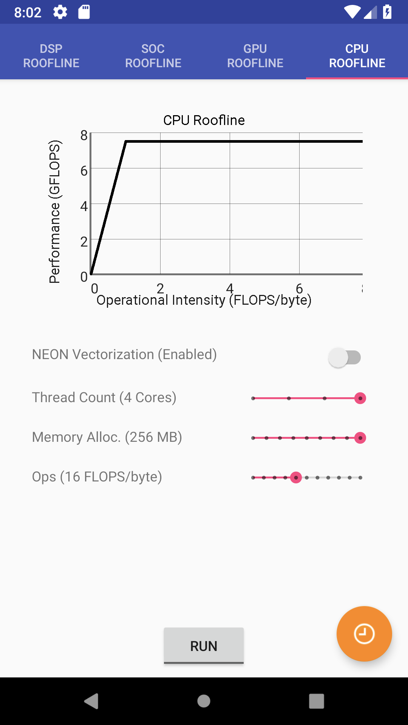
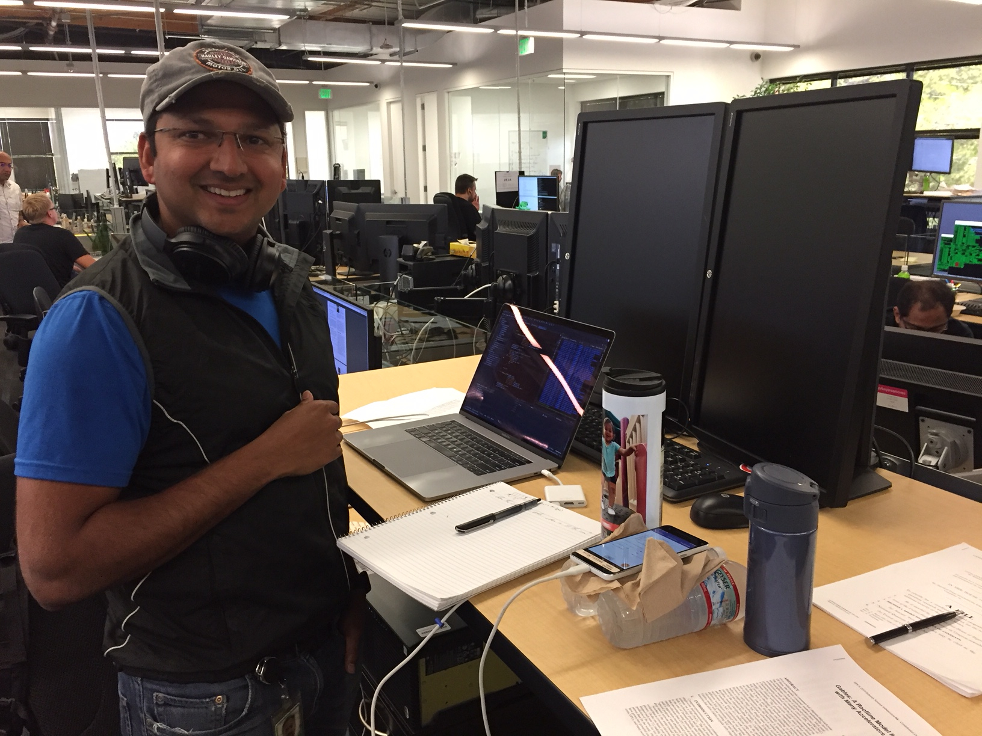

Gables Home Page
Model Extensions
Interactive tool
Gables Android Source at GitHub
http://research.cs.wisc.edu/multifacet/gables/

Slide 51
Mobile System on Chip (SoC)
& Gables
2019 Apple A12 w/ 42 accelerators
SW: Map usecase toIP’s w/ many BWs & acceleration
HW: IP[i] under/over-provisioned for BW or acceleration?
Gables is perhaps a first answer, but not a final answer
51

Slide 52
Outline
Computer History & X-level Parallelism
Mobile SoCs as ALP Harbinger
Gables ALP SoC Model
Call to Action for Accelerator-level Parallelism

Slide 53

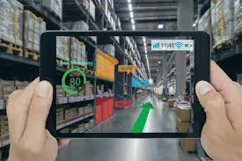


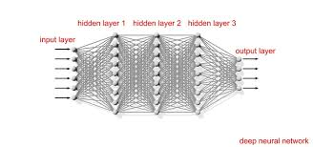
Future Apps Demand Much More Computing

Slide 54
Accelerator-level Parallelism Call to Action
Future apps demand much more computing
Standard tech scaling & architecture NOT sufficient
Mobile SoCs show a promising approach:
ALP = Parallelism among workload components concurrently executing on multiple accelerators (IPs)
Call to action to develop “science” for ubiquitous ALP
It’s the SW stupid!
What SW (model) for a gabled-roof SoC?

Slide 55
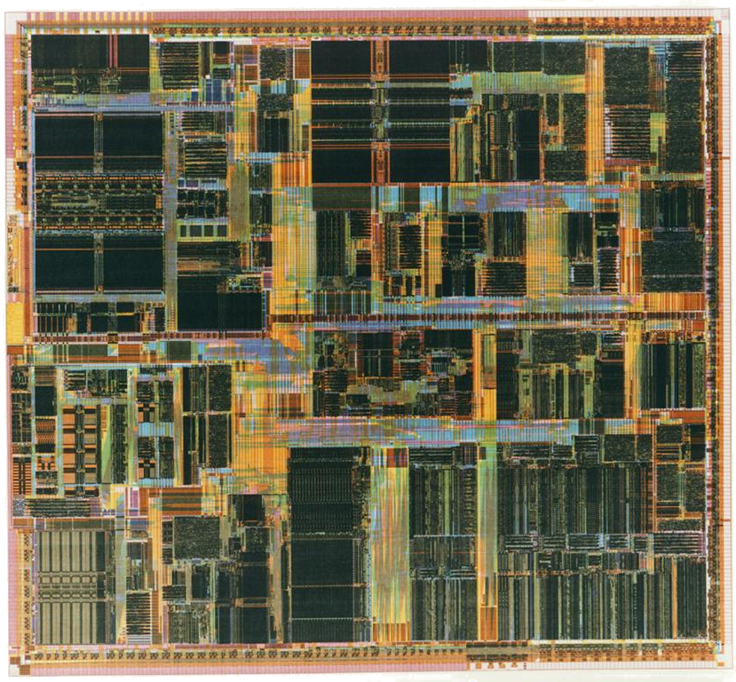
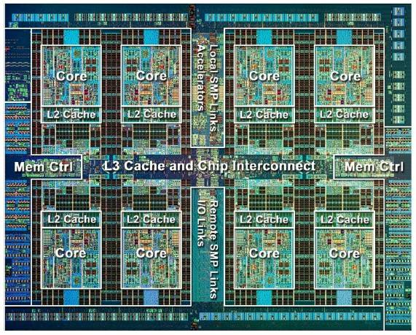
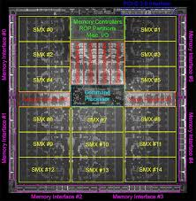
X-level Parallel Hardware + Software (Model)
Single-threaded languages, compilers, runtimes, etc. hides parallelism
Software abstracts TLP, e.g., pThreads, OpenMP, & MPI.
Also hidden in cloud, etc.
Software abstracts TLP+DLP, e.g., CUDA, OpenCL, & graphics OpenGL
Also hidden in cloud, etc.
Local software stack abstracts each accelerator.
But no good, general software abstraction for SoC ALP!
Intel Pentium Pro
BLP+ILP
IBM Power 7
BLP+ILP+TLP
Nvidia GK110
BLP+TLP+DLP
Apple A12
BLP+ILP+TLP+DLP+ALP
Notes:
Pentium Pro ca. 1995+ 5M transistors

Slide 56
ALP/SoC Software Descent to Hellfire!
Local SW stack abstracts each accelerator.
But no good, general SW abstraction for SoC ALP!
No visible parallelism
Any thread-level parallelism, e.g., homogeneous
Thought bridge: Must divide work heterogeneously
Accelerate each differently with unique HLLs (DSLs) & SDKs
P
P P P P
P P P P
P P P P
P P P P
All of above & hide in many kernel drivers ☹
P P P P
P P P P
P P P P
P P P P
P P D E
A A C C
A A C C
A B B B
Uniprocessor
Hellfire!
P P D E
A A C C
A A C C
A B B B
Homogeneous
Multicore
Heterogeneous
Multicore
Heterogeneous
Accelerators
Today: Device
Accelerators
Key: P == processor core; A-E == accelerators
Notes:
Pentium Pro ca. 1995+ 5M transistors

Slide 57
SW+HW Lessons from GP-GPUs?
Programming for data-level parallelism: four decades SIMD→Vectors→SSE→SIMT!
Nvidia GK110
BLP+TLP+DLP
Feature | Then | Now
1. Programming | Graphics OpenGL | SIMT (Cuda/OpenCL/HIP)
2. Concurrency | Either CPU or GPU only; Intra-GPU mechanisms | Finer-grain interaction Intra-GPU mechanisms
3. Communication | Copy data between host & device memories | Maybe shared memory, sometimes coherence
4. Design | Driven by graphics only; GP: $0B market | GP major player, e.g., deep neural networks

Slide 58
SW+HW Directions for ALP?
Need programmability for broad success!!!!
In less than four decades?
Apple A12: BLP+ILP+TLP+DLP+ALP
Feature | Now | Future?
1. Programming | Local: Per-IP DSL & SDK Global: Ad hoc | Abstract ALP/SoC like SIMT does for GP-GPUs
2. Concurrency | Ad hoc | GP-GPU-like scheduling? Virtualize/partition IP?
3. Communication | SW: Up/down OS stack HW: Via off-chip memory | SW+HW for queue pairs? Want control/data planes
4. Design, e.g., select, combine, & size IPs | Ad hoc | Make a “science.” Speed with tools/frameworks

Slide 59
Challenges
Opportunities
Best HW-assist for fine-grain scheduling?
Programmability
Whither global model/runtime?
2. Concurrency
3. Communication
How should SW stack reason about memory, caches, queues, & scratchpads?
When combine “similar” accelerators?
4. Design Space
Science
Hennessy & Patterson: A New Golden Age for Computer Architecture

Slide 60
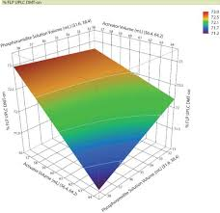
#1: Accelerator Design Space
What is the “right” set of accelerators? For HW? For SW?
When should “similar” accelerators be combined?
When should accelerators share resources (e.g., SRAM)?
How to future-proof for change (e.g., machine learning)?
How should tools/frameworks speed accelerator design?

Slide 61
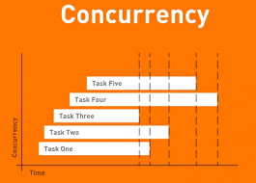
#2: Accelerator Concurrency
How to cooperatively schedule accelerators? By OS or runtime? As devices or processor peers? What HW mechanisms? Note: GPU tasks use runtime & HW
Policies/mechanisms manage/partition/virtualize shared resources (compute, cache/memory, interconnect)?
Whither OS/runtime Hardware Abstraction Layer (HAL)? What should HALs hide/expose?

Slide 62

#3: Accelerator Communication
How do accelerators communicate data? Through memory, shared cache, queues, scratchpads? #copies? Abstraction(s)? Stream dataflow? Idempotent (RDDs)?
Note: GPU memory: discrete→shared→coherent
How do accelerators communicate control? Through interrupts or polling (both bad) Via CPUs? Other?
Separate or unified drivers?

Slide 63
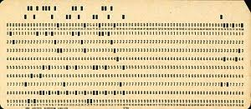
#4: Accelerator Programmability
Each accelerator has domain-specific language (DSL) w/ SDK, JIT, runtime, etc.? Phone ➔ more generally?
Unify multiple accelerator SW “stacks” somehow?
Tools/frameworks to speed SW development? “SW is behind HW” true since 1940s if new SW required
#1-4 needed to delivery ubiquitous ALP to future apps!
Do for ALP what SIMT/runtimes did for GPU TLP+DLP!

Slide 64

Picking Research Problems & ALP
Look for change – gives fresh opportunity
➔ ALP applications, software, & hardware will explode
2. If you can do it, people will care
3. You can do
(some of) it
➔ True for general ALP
Must answer for yourself!

Slide 65
Accelerator-level Parallelism Call to Action
Future apps demand much more computing
Standard tech scaling & architecture NOT sufficient
Mobile SoCs show most/only promising approach:
ALP = Parallelism among workload components concurrently executing on multiple accelerators (IPs)
Call to action to develop “science” for ubiquitous ALP
Hennessy & Patterson: A New Golden Age for Computer Architecture
Science

Slide 66
Backup Slides

Slide 67
Computing Community Consortium
The mission of Computing Research Association's Computing Community Consortium (CCC) is to catalyze the computing research community and enable the pursuit of innovative, high-impact research.
Who
Council ~24 members
CCC/CRA Staff
Chair, VC, & Director
Inputs: Bottom-up, Internal, & Top-Down
What:
Workshops & Conf. Blue Sky Tracks
Whitepapers & Social Media
Reports Out (esp. to government)
Biannual Symposium to DCers
Human Development
Early Career Workshops & Participation
Council Membership
Leadership w/ Gov’t (LISPI)
point successes, lacking SW/HW science
point successes, lacking SW/HW science
Notes:
Established in 2006 as a standing committee of the Computing Research Association
Funded by NSF under a Cooperative Agreement
Facilitates the development of a bold, multi-themed vision for computing research – and communicates this vision to stakeholders
Led by a broad-based Council
Staffed by CRA

Slide 68

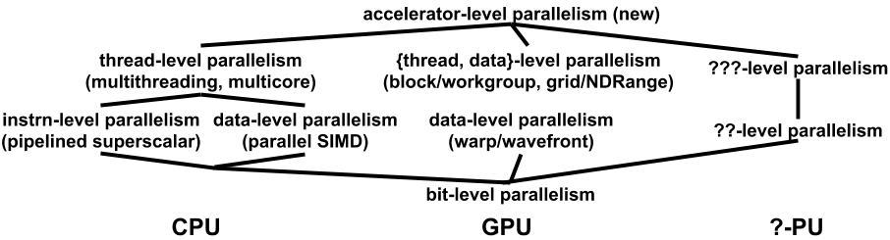
A Parallelism Lattice

Slide 69
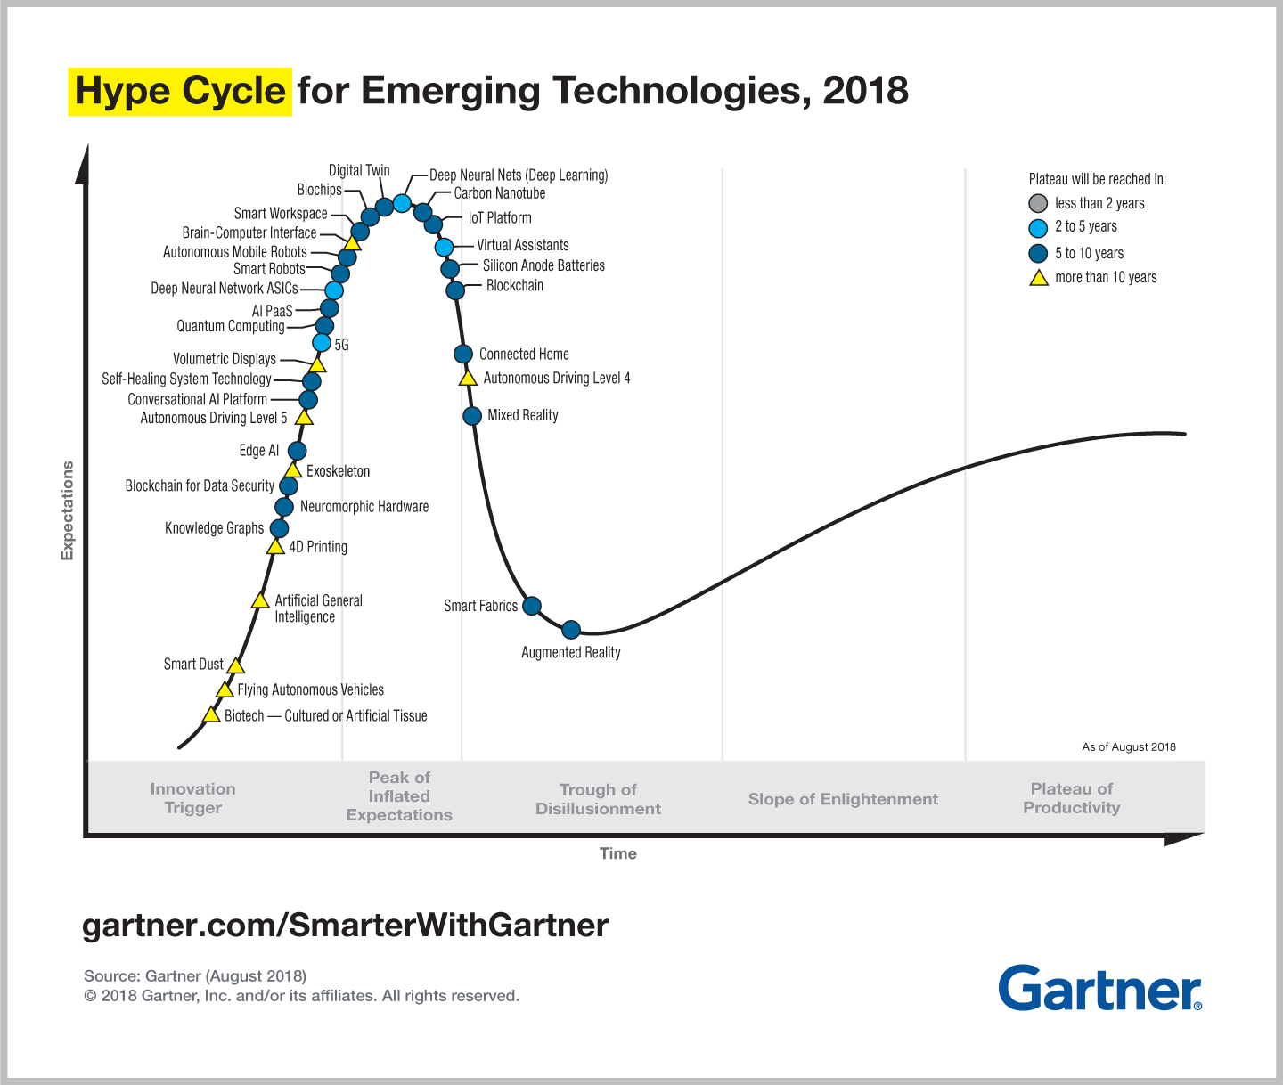
Pitfall X: Design for (Hyped) Importance
IPs should target important workloads, but …
Gartner
Recommend: Provision IP resources (compute & SRAM) only as needed for important usecases

Slide 70

Gables Math: Roofline / Work Fraction
Roofline: MIN(B_{peak} * I, P_{peak})
MIN(B_{peak} * I, 1 * P_{peak}) / 1
1 / T_{IP[i]} = MIN(B_{i} * I_{i}, A_{i} * P_{peak}) / f_{i} f_{i} ≠ 0
1 / T_{memory} = B_{peak} * I_{avg} I_{avg} = 1 / Σ_{i=1,N-1}(f_{i} / I_{i})
Perf = MIN(1/T_{IP[0]} , …1/T_{IP[N-1]}, 1/T_{memory})
70

